Slide 1
YES!

Slide 2
A NEW FUND RAISING INITIATIVE FOR THE KIWANIS CAL-NEV-HA FOUNDATION

Slide 3
WHY?
Notes:
To provide funding which is adaptable to the program needs of the Foundation. Our Primary focus – PTP is well funded, by Kiwanis Clubs and particularly by SLP’s.
Other programs are experiencing growth and are in need of funding:, Leadership training, Scholarships and Grants being the primary programs.

Slide 4
Notes:
If a picture is worth a thousand words, this sums up the point of the YES Initiative.
YOUTH – an initiative which will fund leadership program training for our SLP leadership
EDUCATION – a fund raising program which will enhance the Foundation’s ability to provide scholarships
SUPPORT – YES will provide enhanced grant funding for club grants; Aktion Club grants & Key Leader grants

Slide 5
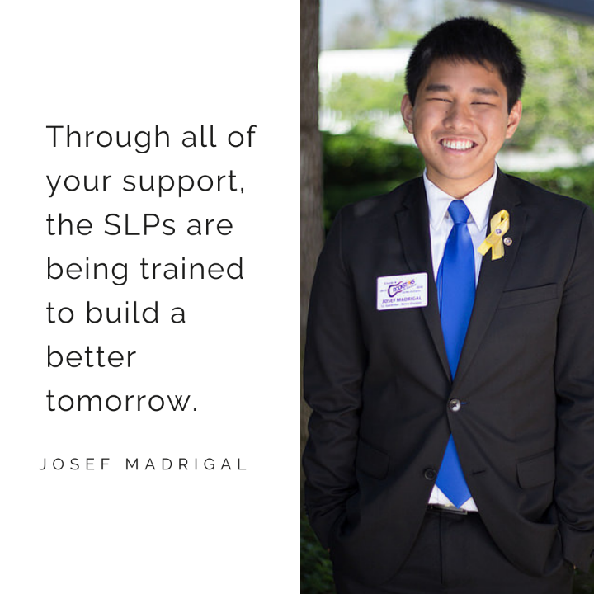
Service Leadership Training
Key Club
Circle K
KIWIN’S
How Much Does the Foundation Invest?
Notes:
YOUTH is the first focus of YES! – The Foundation funds: Candidate Training Conferences, Officers Training Conferences, Spring Board, Summer Board & Winter Board Training Conferences
Over the past five years – KC $200,164; CKI $61,240 and KIWIN’S $44,280 TOTAL? $305,684

Slide 6
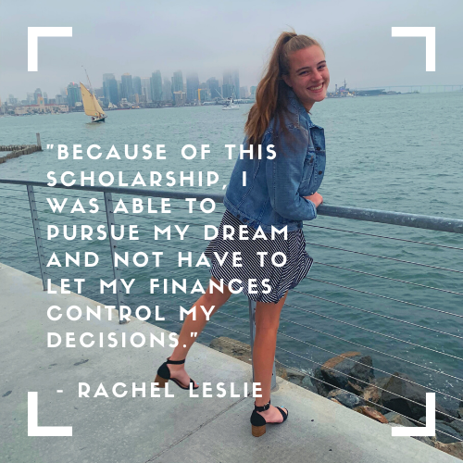
Kenneth C. Forror Sponsored Youth Scholarship Fund
2020 Scholarships
2015 Scholarships
What’s Affecting Our Scholarships?
Notes:
Scholarships - the oldest program of the Foundation (1979-1980) is our 2nd emphasis of YES! – EDUCATION
In 2020 the Foundation’s budgeted amount for scholarships is $85,500
Looking back to 2015 Scholarships were $113,000.
Why the decrease? The SLP Districts have always been the principal contributors to their scholarship funds – by contributing a percentage of their year end surplus; but budget pressures on the SLP Districts have vastly reduced the funds going to their respective scholarship funds – the only solution will be for the foundation to increase funding for scholarships and we need new sources of funds to accomplish this.

Slide 7
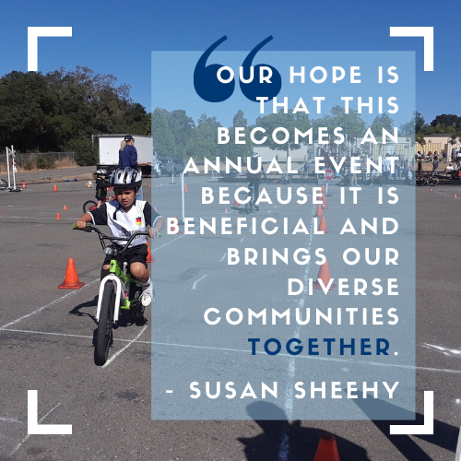
Grants to Clubs & SLP
Club Grants
Aktion Club Grants
Special Grants
Special Olympics
Key Leader
How Much Does the Foundation Invest?
Notes:
3rd focus of YES! – SUPPORT Club grants during 2015-2019 amounted to $97,845; Aktion Club Grants $24,293; Special Grants $10,000; Special Olympics $4,800; Key Leader $3,095
TOTAL GRANTS 2015-2019 $141,859 This is direct support which the Foundation is providing to our Kiwanis Family.

Slide 8
THE YES! INITIATIVE
IS:
A sustaining program
A source of funds for all programs (i.e. club grants)
A means to increase scholarships
A process to continue funding leadership training
IS NOT:
A capital campaign
A building campaign
A debt retirement campaign
An award program
Notes:
Sustaining program vs Capital a capital campaign – we’re seeking monthly, quarterly or annual contributions from donors – not a fixed pledge amount
The Foundation has very successful award programs: Dunlap, DSA, CSA, YSA. We anticipate clubs will continue to recognize community & Kiwanis leaders with these award programs.

Slide 9
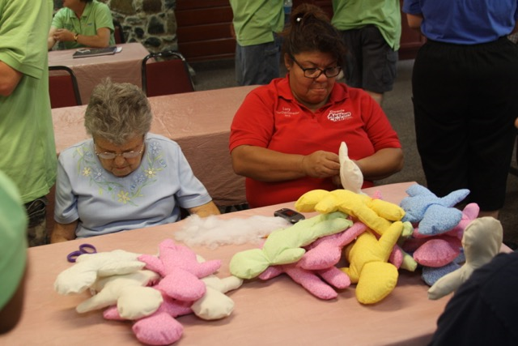
Notes:
WHY?
Because we want to continue funding leadership training, scholarships and grants
This is a grant funded by the Foundation – Aktion Club members are making Hospital dolls / one of our Pediatric Trauma projects

Slide 10
YES! It’s For Everyone!
Notes:
We believe everyone can participate in this Initiative

Slide 11
Impact of Monthly Donations (examples)
 | Monthly Donation | Annual Total | Five Year Total
Members | $25 | $300 | $1,500
Clubs | $50 | $600 | $3,000
Notes:
We deeply appreciate our larger donors and the impact they have; our vision for the YES! Initiative is that over the long term smaller donations will make this initiative sustainable – for both the donor and the Foundation.
These illustrate some examples of monthly giving levels
$1,500 will provide a scholarship for a deserving SLP member
$3,000 will provide a scholarship as well as two club grants

Slide 12
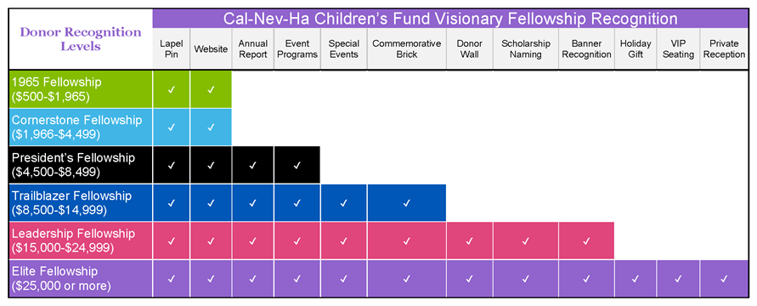
Donor Recognition
Notes:
While we understand donors give to support children and our communities; we never the less want to thank and recognize our supporters as the amount of their gifts to the Initiative increases over time.
Donor recognition begins with a gift of $50 for which the giver receives a YES! Initiative pin
This information comes directly from our donor form for YES! – so you will be able to easily find this grid in the future.

Slide 13
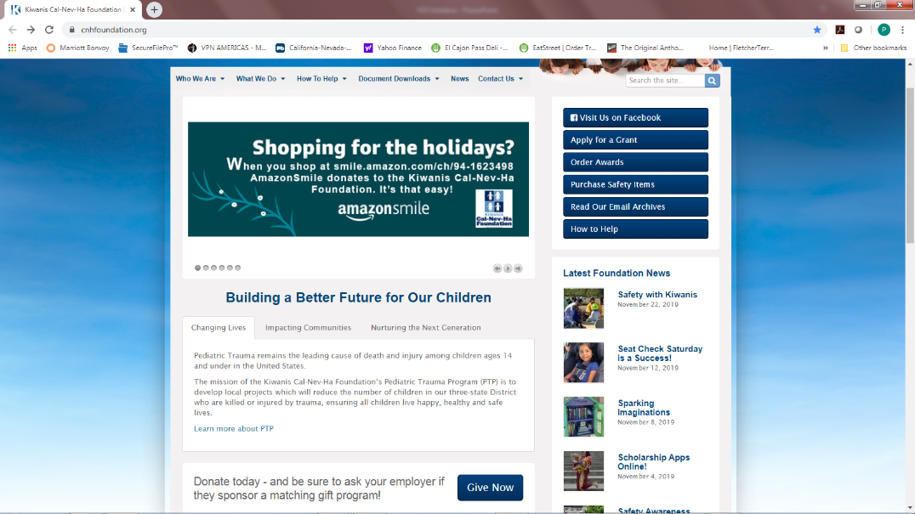
Place your screenshot here
Notes:
This should be an ASK. Ask the audience to use their phone or tablet (or computer) to go to cnhfoundation.org
Click on Give Now

Slide 14
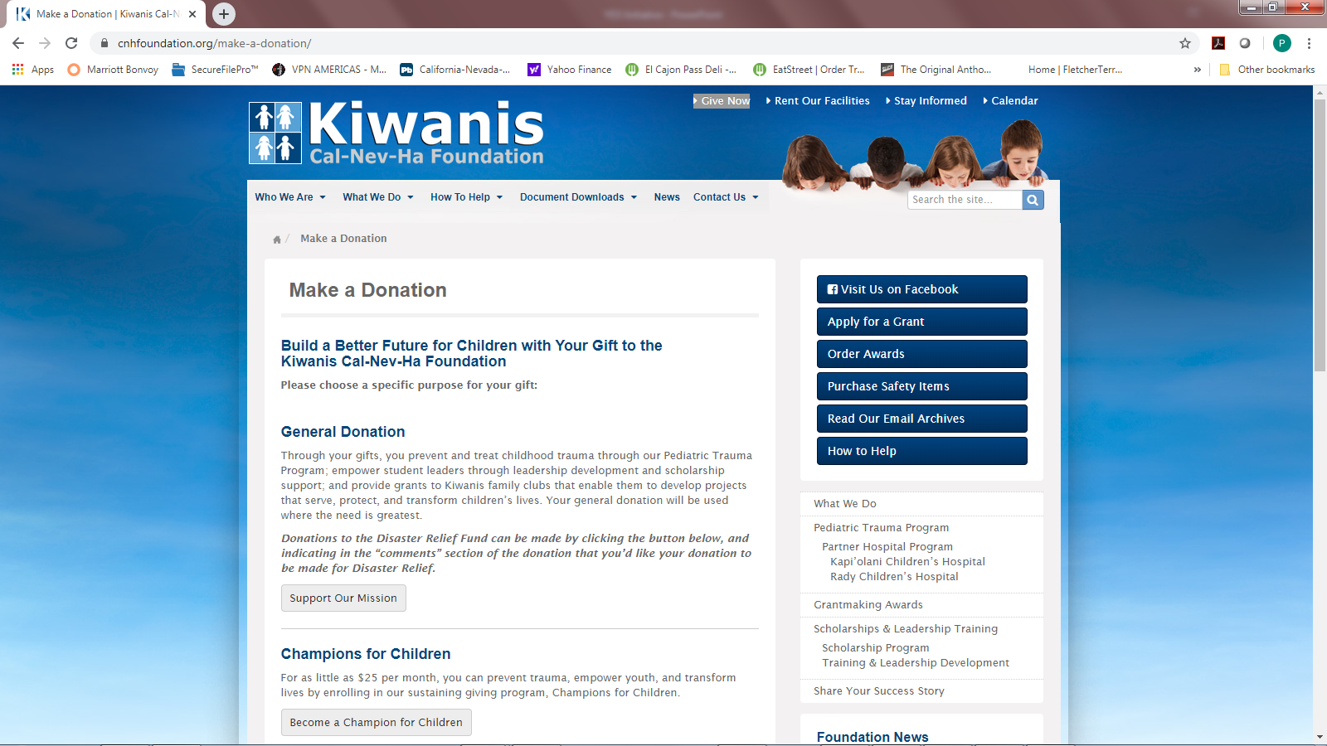
Place your screenshot here
Notes:
Under the heading of General Donation, click on Support our Mission.

Slide 15
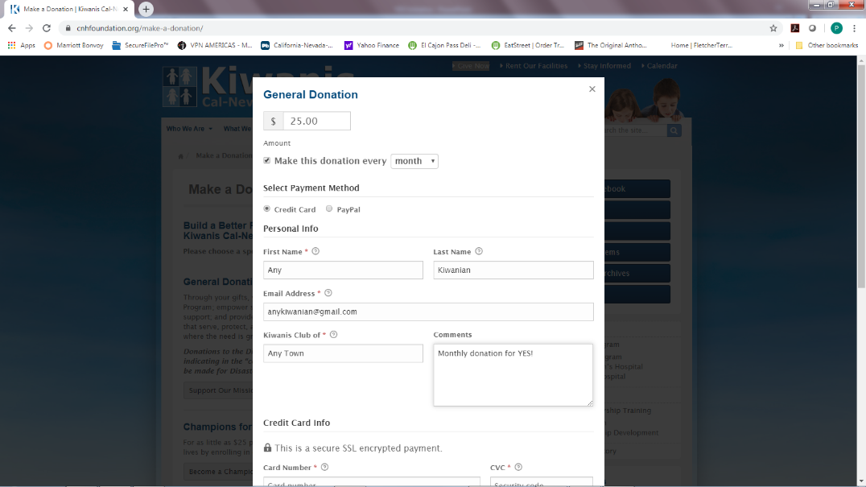
Place your screenshot here
Notes:
Now enter your monthly gift amount, personal information and credit card information at our secure site.
You’re now a member of the YES! Initiative – Thank You!

Slide 16
Thanks!
Any questions?
Pete@cnhkiwanis.org
Jennifer@cnhkiwanis.org
1-909-736-1707

